Slide 1
Cache
Compiled by:
Sarosh shahid

Slide 2
LRU bit
Least recently used (LRU) replacement: the least recently used block in a set evicted in case of N-associative and fully associative caches.
In case of 2-way associative cache, 1-bit is required to keep check of recently used data block.
When a block is accessed its LRU bit will be set to zero (now it’s the least recently used data) and increment all the other values of LRU bit accordingly.
When data is to be evicted from a block, replace the block with maximum value of LRU bit (1 in 2-way associative, 3 in 4-way associative and so on).
Example : Set “i” of a 4-way associative cache
LRU bit | Data block
01 | D0
00 | D1
11 | D2
10 | D3
The LRU bit indicates the sequence of memory access only for this particular set was in order –
D2 D3 D0 D1
And D1 with the least LRU bit value is the most recently accessed

Slide 3
LRU bit
Least recently used (LRU) replacement: the least recently used block in a set evicted in case of N-associative and fully associative caches.
Example : Set “i” of a 4-way associative cache
LRU bit | Data block
01 | D0
00 | D1
11 | D2
10 | D3
LRU bit | Data block
10 | D0
01 | D1
11 | D2
00 | D3
After the data D3 is accessed again
Set the least recently used D3 to 0 and increment all the remaining bit accordingly

Slide 4
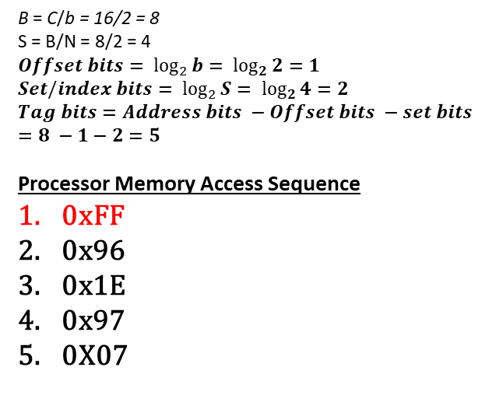
Example 02
Tag Bits Set bits Offset bits
Convert to
binary
0xFF
1111 1111
00 | 00
01 | 01
02 | 02
03 | 03
04 | 04
05 | 05
06 | 06
07 | 07
08 | 08
…….
FD | FD
FE | FE
FF | FF
b = 2B
C = 16B
N = 2 (2-way associative)
Addresses are 8 bits
Sets | V bit | LRU bit | Tags | 0 | 1
00 | 0
 | 0
01 | 0
 | 0
10 | 0
 | 0
11 | 0
 | 0
Sets | V bit | LRU bit | Tags | 0 | 1
00 | 0
 | 0
01 | 0
 | 0
10 | 0
 | 0
11 | 1 | 0 | 11111 | FE | FF
 | 0
B = C/b = 16/2 = 8
S = B/N = 8/2 = 4
$$Offset bits= \log_{2}{b= \log_{2}{2}}=1$$
$$Set/index bits= \log_{2}{S= \log_{2}{4}}=2$$
$$Tag bits=Address bits −Offset bits −set bits=8 −1−2=5$$
Processor Memory Access Sequence
0xFF
0x96
0x1E
0x97
0X07
Cache
Memory
Cache Miss = 1 Cache Hit = 0

Slide 5
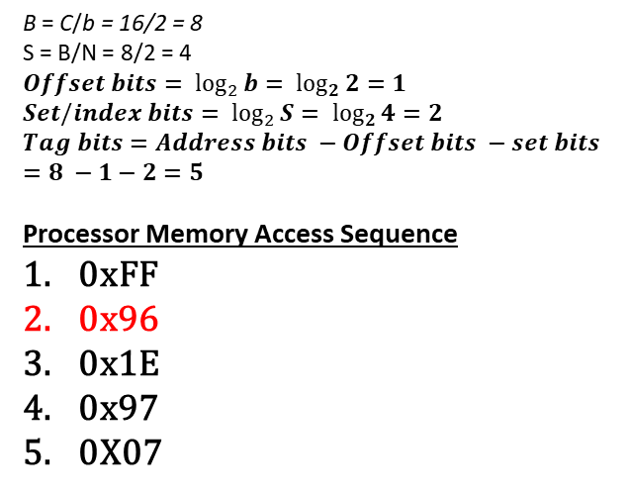
Example 02
Tag Bits Set bits Offset bits
Convert to
binary
0x96
1001 0110
00 | 00
01 | 01
02 | 02
03 | 03
04 | 04
05 | 05
06 | 06
07 | 07
08 | 08
…….
FD | FD
FE | FE
FF | FF
b = 2B
C = 16B
N = 2 (2-way associative)
Addresses are 8 bits
Sets | V bit | LRU bit | Tags | 0 | 1
00 | 0
 | 0
01 | 0
 | 0
10 | 0
 | 0
11 | 1 | 1 | 11111 | FE | FF
 | 1 | 0 | 10010 | 96 | 97
Sets | V bit | LRU bit | Tags | 0 | 1
00 | 0
 | 0
01 | 0
 | 0
10 | 0
 | 0
11 | 1 | 0 | 11111 | FE | FF
 | 0
B = C/b = 16/2 = 8
S = B/N = 8/2 = 4
$$Offset bits= \log_{2}{b= \log_{2}{2}}=1$$
$$Set/index bits= \log_{2}{S= \log_{2}{4}}=2$$
$$Tag bits=Address bits −Offset bits −set bits=8 −1−2=5$$
Processor Memory Access Sequence
0xFF
0x96
0x1E
0x97
0X07
Cache
Memory
Cache Miss = 2 Cache Hit = 0

Slide 6
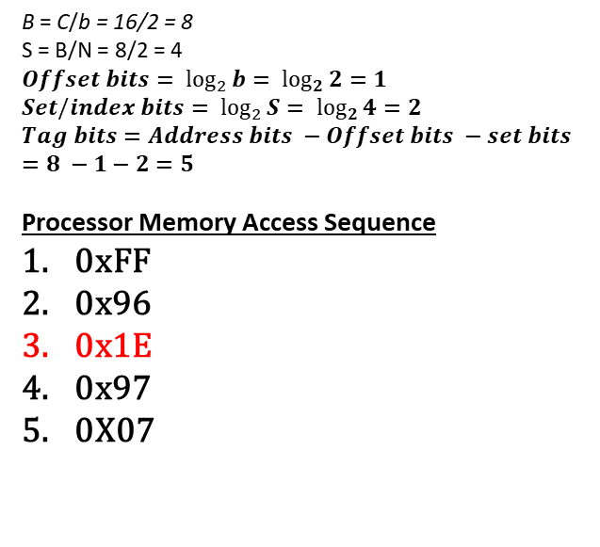
Example 02
Tag Bits Set bits Offset bits
Convert to
binary
0x1E
0001 1110
00 | 00
01 | 01
02 | 02
03 | 03
04 | 04
05 | 05
06 | 06
07 | 07
08 | 08
…….
FD | FD
FE | FE
FF | FF
b = 2B
C = 16B
N = 2 (2-way associative)
Addresses are 8 bits
Sets | V bit | LRU bit | Tags | 0 | 1
00 | 0
 | 0
01 | 0
 | 0
10 | 0
 | 0
11 | 1 | 1 | 11111 | FE | FF
 | 1 | 0 | 10010 | 96 | 97
Sets | V bit | LRU bit | Tags | 0 | 1
00 | 0
 | 0
01 | 0
 | 0
10 | 0
 | 0
11 | 1 | 0 | 00011 | 1E | 1F
 | 1 | 1 | 10010 | 96 | 97
B = C/b = 16/2 = 8
S = B/N = 8/2 = 4
$$Offset bits= \log_{2}{b= \log_{2}{2}}=1$$
$$Set/index bits= \log_{2}{S= \log_{2}{4}}=2$$
$$Tag bits=Address bits −Offset bits −set bits=8 −1−2=5$$
Processor Memory Access Sequence
0xFF
0x96
0x1E
0x97
0X07
Cache
Memory
Cache Miss = 3 Cache Hit = 0

Slide 7
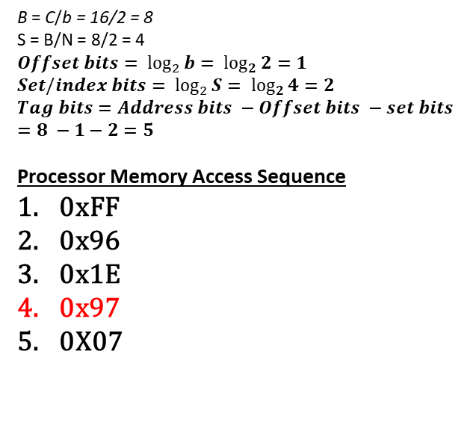
Example 02
Tag Bits Set bits Offset bits
Convert to
binary
0x97
1001 0111
00 | 00
01 | 01
02 | 02
03 | 03
04 | 04
05 | 05
06 | 06
07 | 07
08 | 08
…….
FD | FD
FE | FE
FF | FF
b = 2B
C = 16B
N = 2 (2-way associative)
Addresses are 8 bits
Sets | V bit | LRU bit | Tags | 0 | 1
00 | 0
 | 0
01 | 0
 | 0
10 | 0
 | 0
11 | 1 | 1 | 00011 | 1E | 1F
 | 1 | 0 | 10010 | 96 | 97
Sets | V bit | LRU bit | Tags | 0 | 1
00 | 0
 | 0
01 | 0
 | 0
10 | 0
 | 0
11 | 1 | 0 | 00011 | 1E | 1F
 | 1 | 1 | 10010 | 96 | 97
B = C/b = 16/2 = 8
S = B/N = 8/2 = 4
$$Offset bits= \log_{2}{b= \log_{2}{2}}=1$$
$$Set/index bits= \log_{2}{S= \log_{2}{4}}=2$$
$$Tag bits=Address bits −Offset bits −set bits=8 −1−2=5$$
Processor Memory Access Sequence
0xFF
0x96
0x1E
0x97
0X07
Cache
Memory
Cache Miss = 3 Cache Hit = 1

Slide 8
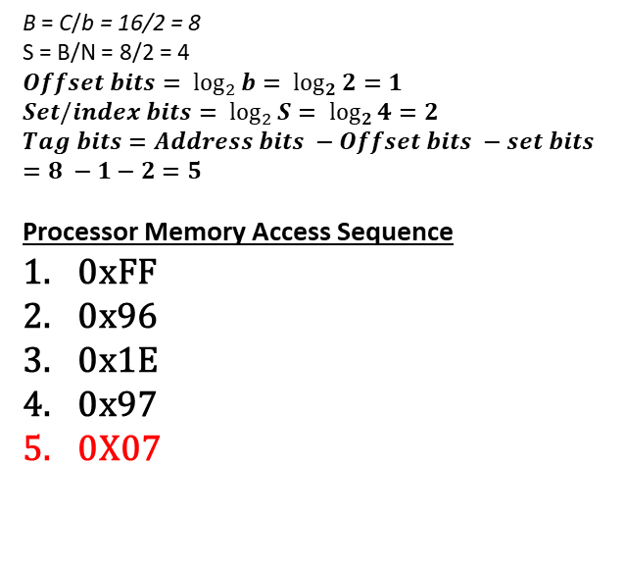
Example 02
Tag Bits Set bits Offset bits
Convert to
binary
0x07
0000 0111
00 | 00
01 | 01
02 | 02
03 | 03
04 | 04
05 | 05
06 | 06
07 | 07
08 | 08
…….
FD | FD
FE | FE
FF | FF
b = 2B
C = 16B
N = 2 (2-way associative)
Addresses are 8 bits
Sets | V bit | LRU bit | Tags | 0 | 1
00 | 0
 | 0
01 | 0
 | 0
10 | 0
 | 0
11 | 1 | 1 | 00011 | 1E | 1F
 | 1 | 0 | 10010 | 96 | 97
Sets | V bit | LRU bit | Tags | 0 | 1
00 | 0
 | 0
01 | 0
 | 0
10 | 0
 | 0
11 | 1 | 0 | 00000 | 06 | 07
 | 1 | 1 | 10010 | 96 | 97
B = C/b = 16/2 = 8
S = B/N = 8/2 = 4
$$Offset bits= \log_{2}{b= \log_{2}{2}}=1$$
$$Set/index bits= \log_{2}{S= \log_{2}{4}}=2$$
$$Tag bits=Address bits −Offset bits −set bits=8 −1−2=5$$
Processor Memory Access Sequence
0xFF
0x96
0x1E
0x97
0X07
Cache
Memory
Cache Miss = 4 Cache Hit = 1

Slide 9
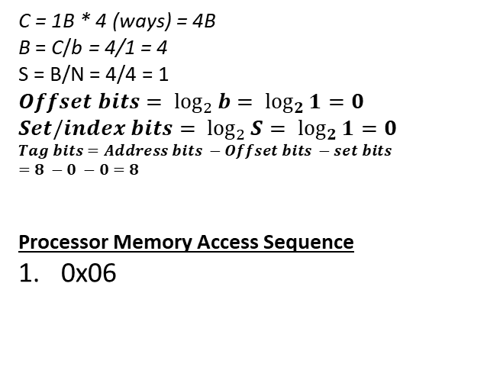
Example 03
Tag Bits Set bits Offset bits
Convert to
binary
0x06
0000 0110
00 | 00
01 | 01
02 | 02
03 | 03
04 | 04
05 | 05
06 | 06
07 | 07
08 | 08
……. | …….
FD | FD
FE | FE
FF | FF
b = 1B
Full Associative Cache
Single set with 4-ways
Address is 8bits
Set | V bit | LRU bit | Tags | Data
 | 1 | 00 | 0000 0110 | 06
 | 0
 | 0
 | 0
C = 1B * 4 (ways) = 4B
B = C/b = 4/1 = 4
S = B/N = 4/4 = 1
$$Offset bits= \log_{2}{b= \log_{2}{1}}=0$$
$$Set/index bits= \log_{2}{S= \log_{2}{1}}=0$$
$$Tag bits=Address bits −Offset bits −set bits$$
$$=8 −0 −0=8$$
Processor Memory Access Sequence
0x06
Cache
Memory
Cache Miss = 1 Cache Hit = 0

Slide 10
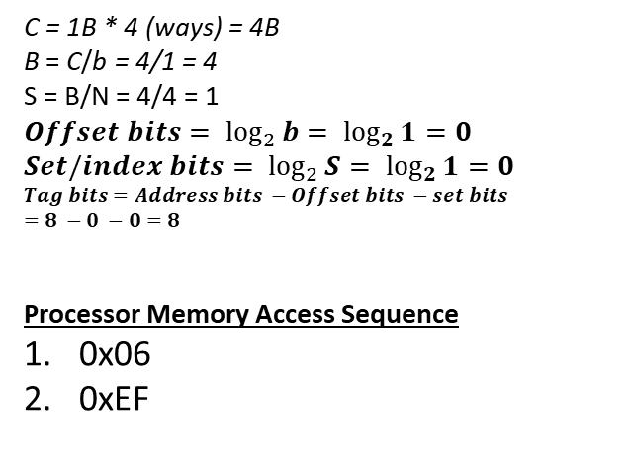
Example 03
Tag Bits Set bits Offset bits
Convert to
binary
0xEF
1110 1111
00 | 00
01 | 01
02 | 02
03 | 03
04 | 04
05 | 05
06 | 06
07 | 07
08 | 08
……. | …….
FD | FD
FE | FE
FF | FF
b = 1B
Full Associative Cache
Single set with 4-ways
Address is 8bits
Set | V bit | LRU bit | Tags | Data
 | 1 | 01 | 0000 0110 | 06
 | 1 | 00 | 1110 1111 | EF
 | 0
 | 0
C = 1B * 4 (ways) = 4B
B = C/b = 4/1 = 4
S = B/N = 4/4 = 1
$$Offset bits= \log_{2}{b= \log_{2}{1}}=0$$
$$Set/index bits= \log_{2}{S= \log_{2}{1}}=0$$
$$Tag bits=Address bits −Offset bits −set bits$$
$$=8 −0 −0=8$$
Processor Memory Access Sequence
0x06
0xEF
Cache
Memory
Cache Miss = 2 Cache Hit = 0

Slide 11
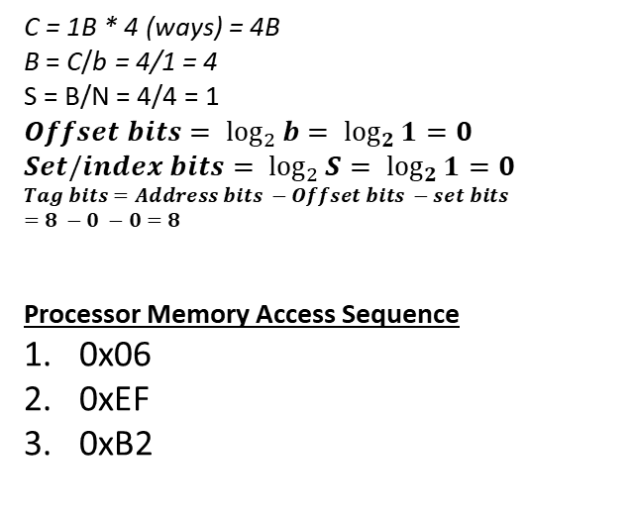
Example 03
Tag Bits Set bits Offset bits
Convert to
binary
0xB2
1011 0010
00 | 00
01 | 01
02 | 02
03 | 03
04 | 04
05 | 05
06 | 06
07 | 07
08 | 08
……. | …….
FD | FD
FE | FE
FF | FF
b = 1B
Full Associative Cache
Single set with 4-ways
Address is 8bits
Set | V bit | LRU bit | Tags | Data
 | 1 | 10 | 0000 0110 | 06
 | 1 | 01 | 1110 1111 | EF
 | 1 | 00 | 1011 0010 | B2
 | 0
C = 1B * 4 (ways) = 4B
B = C/b = 4/1 = 4
S = B/N = 4/4 = 1
$$Offset bits= \log_{2}{b= \log_{2}{1}}=0$$
$$Set/index bits= \log_{2}{S= \log_{2}{1}}=0$$
$$Tag bits=Address bits −Offset bits −set bits$$
$$=8 −0 −0=8$$
Processor Memory Access Sequence
0x06
0xEF
0xB2
Cache
Memory
Cache Miss = 3 Cache Hit = 0

Slide 12
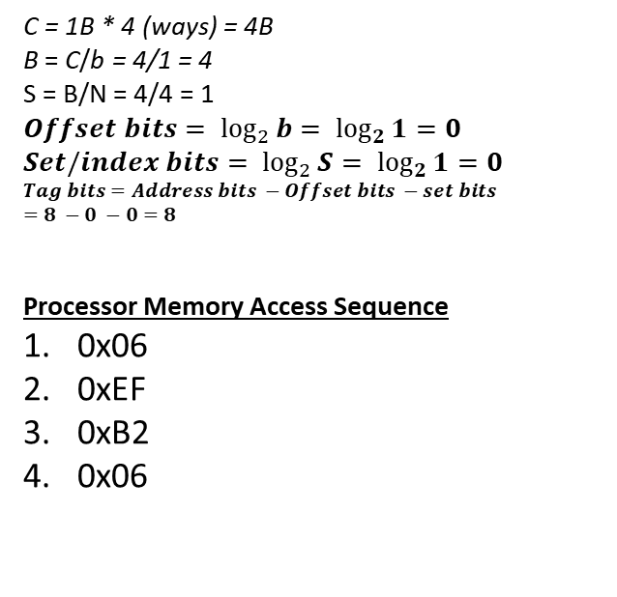
Example 03
Tag Bits Set bits Offset bits
Convert to
binary
0x06
0000 0110
00 | 00
01 | 01
02 | 02
03 | 03
04 | 04
05 | 05
06 | 06
07 | 07
08 | 08
……. | …….
FD | FD
FE | FE
FF | FF
b = 1B
Full Associative Cache
Single set with 4-ways
Address is 8bits
Set | V bit | LRU bit | Tags | Data
 | 1 | 00 | 0000 0110 | 06
 | 1 | 10 | 1110 1111 | EF
 | 1 | 01 | 1011 0010 | B2
 | 0
C = 1B * 4 (ways) = 4B
B = C/b = 4/1 = 4
S = B/N = 4/4 = 1
$$Offset bits= \log_{2}{b= \log_{2}{1}}=0$$
$$Set/index bits= \log_{2}{S= \log_{2}{1}}=0$$
$$Tag bits=Address bits −Offset bits −set bits$$
$$=8 −0 −0=8$$
Processor Memory Access Sequence
0x06
0xEF
0xB2
0x06
Cache
Memory
Respective tag found so it’s a cache hit
Cache Miss = 3 Cache Hit = 1

Slide 13
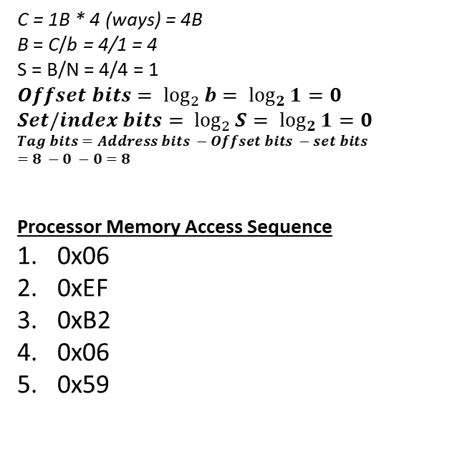
Example 03
Tag Bits Set bits Offset bits
Convert to
binary
0x59
0101 1001
00 | 00
01 | 01
02 | 02
03 | 03
04 | 04
05 | 05
06 | 06
07 | 07
08 | 08
……. | …….
FD | FD
FE | FE
FF | FF
b = 1B
Full Associative Cache
Single set with 4-ways
Address is 8bits
Set | V bit | LRU bit | Tags | Data
 | 1 | 01 | 0000 0110 | 06
 | 1 | 11 | 1110 1111 | EF
 | 1 | 10 | 1011 0010 | B2
 | 1 | 00 | 0101 1001 | 59
C = 1B * 4 (ways) = 4B
B = C/b = 4/1 = 4
S = B/N = 4/4 = 1
$$Offset bits= \log_{2}{b= \log_{2}{1}}=0$$
$$Set/index bits= \log_{2}{S= \log_{2}{1}}=0$$
$$Tag bits=Address bits −Offset bits −set bits$$
$$=8 −0 −0=8$$
Processor Memory Access Sequence
0x06
0xEF
0xB2
0x06
0x59
Cache
Memory
Cache Miss = 4 Cache Hit = 1

Slide 14
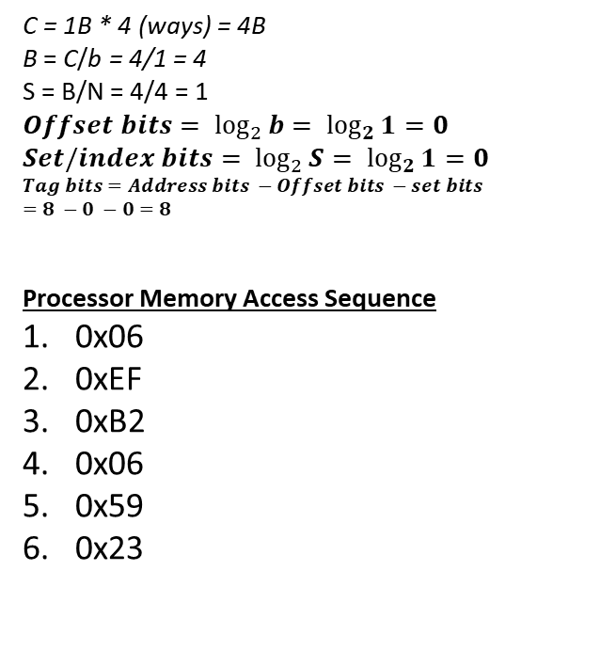
Example 03
Tag Bits Set bits Offset bits
Convert to
binary
0x59
0010 0011
00 | 00
01 | 01
02 | 02
03 | 03
04 | 04
05 | 05
06 | 06
07 | 07
08 | 08
……. | …….
FD | FD
FE | FE
FF | FF
b = 1B
Full Associative Cache
Single set with 4-ways
Address is 8bits
Set | V bit | LRU bit | Tags | Data
 | 1 | 10 | 0000 0110 | 06
 | 1 | 00 | 0010 0011 | 23
 | 1 | 11 | 1011 0010 | B2
 | 1 | 01 | 0101 1001 | 59
C = 1B * 4 (ways) = 4B
B = C/b = 4/1 = 4
S = B/N = 4/4 = 1
$$Offset bits= \log_{2}{b= \log_{2}{1}}=0$$
$$Set/index bits= \log_{2}{S= \log_{2}{1}}=0$$
$$Tag bits=Address bits −Offset bits −set bits$$
$$=8 −0 −0=8$$
Processor Memory Access Sequence
0x06
0xEF
0xB2
0x06
0x59
0x23
Cache
Memory
Cache Miss = 4 Cache Hit = 1

Slide 15
Types of Cache Misses
Compulsory Miss:
The first request to a cache block is called a compulsory miss, because the block must be read from memory regardless of the cache design.
Capacity Miss:
Capacity misses occur when the cache is too small to hold all concurrently used data.
Conflict Miss:
Conflict misses are caused when several addresses map to the same set and evict blocks that are still needed.

Slide 16
Cache Parameters
Increasing cache capacity can reduce conflict and capacity misses, but it does not affect compulsory misses.
Increasing block size could reduce compulsory misses (due to spatial locality). But as block size increases, the number of sets in a fixed-size cache decreases, increasing the probability of conflicts.
An N-way set associative cache reduces conflicts by providing N blocks in each set where data mapping to that set might be found. Each memory address still maps to a specific set, but it can map to any one of the N blocks in the set. However, set associative caches are usually slower and somewhat more expensive to build

